Slide 1
Java Programming: From the Ground Up
Lecture Notes 17
Chapter 18 – Part 1
Graphics: AWT and Swing

Slide 2
Objectives
Understand Java’s Component classes
Understand AWT and Swing
Understand containers
Understand windows
Understand frames
Understand layout managers

Slide 3
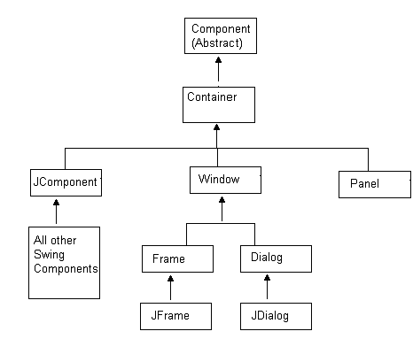
Components and Containers
Java provides a hierarchy of classes that facilitates GUI programming, Java’s Component hierarchy

Slide 4
Components and Containers
At the top of the hierarchy is the (abstract) Component class.
A component is an object that can be displayed on the screen.
Buttons, text boxes, checkboxes and labels are all components.
A window is also a component.
Every component, such as a button, a checkbox, a text box, or a window is an object belonging to some class that extends Component.
The upper left corner of a container is designated as position (0, 0) and (x, y) is the point located x pixels to the right of and y pixels down from (0, 0).

Slide 5
Component methods
void setSize (int width, int height)
sets the size of a component so that its width is width pixels and its height is height pixels. This method can be used to resize a button or a window.
void setLocation(int x, int y)
places a component at position (x, y) of the container that holds it When a component is placed at position (x, y), the upper left-hand corner of the component is placed at (x, y).
void setBounds(int x, int y, int width, int height)
places a component at position (x, y) and resizes the component to the number of pixels specified by the parameters width and height.

Slide 6
Component methods
void setEnabled(boolean enable)
enables the component if the parameter, enable, is true; disables the component if enable is false. If a button is enabled, clicking the button usually triggers some program action.
void setVisible(boolean x)
hides the component if the parameter is false; displays the component if the parameter is true.
void setName(String name)
sets the name of the component.
int getHeight()
returns the height in pixels of a component.
int getWidth()
returns the width in pixels of a component.

Slide 7
Component methods
int getX()
returns the x-coordinate of the component, i.e., the x-coordinate of the upper left corner of the component.
int getY()
returns the y-coordinate of the component, i.e., the y-coordinate of the upper left corner of the component.
String getName()
returns the name of the component.
boolean isEnabled()
returns true if the component is enabled, false otherwise.
boolean isVisible()
returns true if the component is visible when its container is visible, false otherwise. Note, that a visible component does not display if its parent container is not also visible.

Slide 8
Container class
The Container class defines additional methods. The most important of these is
Component add(Component c),
which places a component, c, in a container and returns c.

Slide 9
Abstract Windows Toolkit and Swing
Java provides two packages that contain the classes for graphics programming:
the original Abstract Windows Toolkit (AWT) and
the newer Swing package.
Swing does not replace AWT.
Swing uses many AWT classes.
Swing provides new user interface components (buttons, textboxes, checkboxes, menus etc.) which are platform independent.
The AWT classes are in java.awt
The Swing classes reside in javax.swing.

Slide 10
AWT and Swing
AWT in java.awt | Swing in javax.swing
Each component is mapped to a corresponding platform-dependent interface called a peer. Platform specific and prone to platform specific bugs. Components may look different on different platforms. Components have the look of a particular platform. | No platform dependent peers. Code written in Java. All components look the same, regardless of the platform Components are all prefixed with “J,” e.g., JButton, JCheckbox, JLabel

Slide 11
Swing Classes
Swing classes are all prefixed with uppercase J. For example JButton, JCheckBox, JWindow and JMenu are Swing classes that encapsulate buttons, checkboxes, windows, and menus.
All Swing components except JFrame and JDialog extend JComponent, while JFrame and JDialog extend Frame and Dialog respectively.

Slide 12
Windows and Frames
Every GUI utilizes one or more windows.
The Window class extends Container.
A Java Window is a “window” without borders and a title bar.
The Frame class, a member of AWT, extends Window.
A Frame is-a Window that includes a title bar and border.
JFrame is a Swing class that extends the AWT class Frame.
A JFrame object is a container for other objects such as buttons, labels, text boxes, and checkboxes.

Slide 13
Windows and Frames
JFrame encapsulates what you normally think of as a “window,” and it is the primary container used in all our applications.
Two JFrame constructors are:
JFrame()
creates a new JFrame that is initially invisible.
JFrame(String title)
creates a new JFrame with title, title, that is initially invisible. When the frame is visible, the title appears on the title bar of the frame.

Slide 14
JFrame Methods
void setTitle(String title)
sets the title of the frame to title.
void setResizable(boolean x)
If x is true, the frame can be resized by the user; if x is false the frame cannot be resized. By default, a frame is resizable.
void setDefaultCloseOperation(int op)
exits the application when the user closes the frame, provided that op is the JFrame constant EXIT_ON_CLOSE. If the close operation is not set with EXIT_ON_CLOSE, then when a user closes the application by clicking on the x in the upper right hand corner of the window, the window disappears but the process still runs in the background.

Slide 15
JFrame Methods
To add components to a frame use
the add(Component c) method of Container
and
the setVisible(boolean x) method of Component to make a JFrame visible.

Slide 16
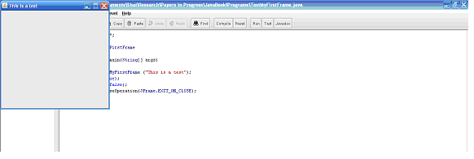
JFrame Methods
Problem Statement Design a class that extends JFrame. Include two constructors. The default constructor sets the title to “I’ve been framed!” A one argument constructor accepts a String parameter, title. The frame should be positioned at (0,0) on the user screen. The dimensions of the frame should be 300 by 300 pixels.
A frame in the upper left-hand corner of the screen

Slide 17
The Application
The upper left corner of the screen has coordinates (0, 0). A call to setBounds (0, 0, 300, 300) places the upper left corner of the frame at screen position (0,0).
import javax.swing.*;
public class MyFirstFrame extends JFrame
{
public MyFirstFrame () // creates a frame with title "I've been framed!"
{
super("I've been framed!"); // call the one-argument constructor of JFrame
setBounds(0,0,300,300); // placed at screen position (0,0); size 300 by 300
}
public MyFirstFrame (String title) // creates a frame with title title
{
super(title); // call the one-argument constructor of JFrame
setBounds(0,0,300,300); // placed at (0,0); size 300 by 300
}
}

Slide 18
A test class that creates, displays, and closes a MyFirstFrame frame
import javax.swing.*;
public class TestMyFirstFrame
{
public static void main(String[] args)
{
JFrame frame = new MyFirstFrame ("This is a test");
frame.setVisible(true);
frame.setResizable(false);
frame.setDefaultCloseOperation(JFrame.EXIT_ON_CLOSE);
}
}

Slide 19
How to center a frame
Place a frame of size 200 by 100 pixels in the center of the screen.
If the screen size (resolution) is 800 by 600 then the upper right hand corner of the frame should be positioned at (x, y) such that
x = (800 – 200)/ 2 = 300
y = (600 – 100)/ 2 = 250
If the screen resolution is 1024 by 768 then a centered 200 by 100 frame should be positioned at:
x = (1024 – 200)/2 = 412
y = (768 – 100)/ 2 = 334

Slide 20
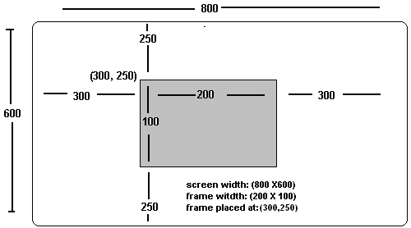
Centering a 200 by 100 frame

Slide 21
Toolkit and Dimension Classes
To center a frame on a screen of any size, use methods of the AWT classes
Toolkit
Dimension
The Dimension class has two public fields,
int width and
Int height,
that hold the screen dimensions
The Toolkit class contains a method Dimension getScreenSize(), that returns a Dimension object.

Slide 22
Use the Toolkit and Dimension classes to obtain the screen size
Toolkit toolkit = Toolkit.getDefaultToolkit(); // a static method of the Toolkit class
Dimension dimensions = toolkit.getScreenSize(); // dimensions.width is the width of the screen
// dimensions.height is the height of the screen

Slide 23
Point class
The Point class encapsulates a two dimensional point.
The Point class has two public fields
int x and
int y
that denote the horizontal and vertical coordinates of a two dimensional point.
The class has a two-argument constructor
Point (int x, int y)
that sets the values of x and y.

Slide 24
A CenterFrame class
Problem Description
Develop a class CenterFrame with a single static method
public static Point getPosition(int frameWidth, int frameHeight)
that, given the width and height of a frame, returns a Point that holds the coordinates, x and y, of the position where the frame should be placed so that it is centered on the screen.

Slide 25
A CenterFrame class
import java.awt.*;
public class CenterFrame // a utility class
{
public static Point getPosition(int frameWidth, int frameHeight)
{
// frame size is width * height
// returns a Point holding the coordinates of
// the upper left-hand corner of the (centered) frame
Toolkit toolkit = Toolkit.getDefaultToolkit();
Dimension dimensions =toolkit.getScreenSize();
int x = (dimensions.width - frameWidth)/2; // x coordinate of upper left corner
int y = (dimensions.height - frameHeight)/2; // y coordinate of upper left corner
return (new Point(x,y)); // return coordinates as a Point object
}
}

Slide 26
Layout Managers
To add components to a frame, Java provides layout managers.
A layout manager is an object that arranges components in a container such as a frame. The layout manager classes implement the LayoutManager interface.
Different layout managers arrange widgets differently.
Three common layout managers are :
BorderLayout,
FlowLayout, and
GridLayout.

Slide 27
BorderLayout
BorderLayout is the default layout manager for JFrame.
The BorderLayout manager divides a frame into five areas:
NORTH WEST SOUTH EAST CENTER

Slide 28
BorderLayout
Constructors
BorderLayout()
BorderLayout(int horizontalgap, int verticalgap) where horizontalgap and verticalgap specify horizontal and vertical space, in pixels, between components.
The method
add(Component c, int region)
places a component into a container.
The parameter, region, is specified by one of the constants
BorderLayout.NORTH,
BorderLayout.SOUTH,
BorderLayout.EAST,
BorderLayout.WEST, or
BorderLayout.CENTER.
If no region is specified, a BorderLayout layout manager places a component in the center region. Only one component can be placed in a region and components are resized to fit the region.

Slide 29
BorderLayout
Problem Statement
Create a class, BorderLayoutFrame, that extends JFrame such that an object belonging to BorderLayoutFrame displays five buttons.
A button is a widget that displays some text or image and allows some action to occur when the button is “pressed” – i.e., when the mouse is clicked on the button.

Slide 30
BorderLayout
Arrange the five buttons in the frame using the default BorderLayout layout manager. The center button should display the famous “smiley face” image stored in smiley.jpg. The other four buttons should display the word smile in four languages: English, French (sourire), Italian (sorriso), and Spanish (sonrisa).
The size of the frame should be 300 by 300 and the frame should be positioned at (0,0). Include a main(...) method that instantiates the frame.

Slide 31
A Button
A button is a member of the JButton class.
Three constructors of JButton are:
JButton(), creates a button with no text
JButton(String text), text is text displayed on the button,
JButton(new ImageIcon (String filename)) displays an image on the button , where filename is the name of an image file, such as myPicture.jpg or yourPicture.gif.

Slide 32
The Application
import javax.swing.*;
import java.awt.*;
public class BorderLayoutFrame extends JFrame
{
public BorderLayoutFrame()
{
super("BorderLayout "); // call one-argument constructor of JFrame
setBounds(0,0, 300,300); // position and size
// add the center button that displays the image in "smiley.jpg"
add(new JButton(new ImageIcon("smiley.jpg")), BorderLayout.CENTER)
// add four buttons to NORTH, SOUTH, EAST, and WEST
add(new JButton("Smile"), BorderLayout.NORTH);
add(new JButton("Sourire"),BorderLayout.SOUTH);
add(new JButton("Sorriso"), BorderLayout.EAST);
add(new JButton("Sonrisa"),BorderLayout.WEST);
}
public static void main(String[] args) // for display purposes
{
JFrame frame = new BorderLayoutFrame ();
frame.setVisible(true);
frame.setDefaultCloseOperation(JFrame.EXIT_ON_CLOSE);
}
}

Slide 33
Five JButtons, one displaying an ImageIcon, placed with the default layout manager, BorderLayout

Slide 34
Discussion
If the additional statement
add(new JButton( ":)" ),BorderLayout.CENTER);
is added to the constructor at line 16, the frame would appear as
Each button fills its region.
If the frame is expanded, so are the buttons.
The frame can hold only five components, and components can be covered by other components.

Slide 35
FlowLayout
An object belonging to FlowLayout arranges components horizontally in a container, left to right, row by row, in the order in which they are added to the container.
FlowLayout() instantiates a FlowLayout layout manager object that center aligns components in a container.
FlowLayout( int Alignment) instantiates a FlowLayout layout manager with the specified alignment: FlowLayout.LEFT, FlowLayout.CENTER, or FlowLayout.RIGHT, with integer values 0, 1, and 2 respectively.
FlowLayout(int Alignment, int horizontalSpace, int verticalSpace) instantiates a FlowLayout layout manager with the specified alignment. Parameters horizontalSpace and verticalSpace specify horizontal and vertical space, in pixels, between components

Slide 36
setLayout
The JFrame method
setLayout(LayoutManager m);
sets the layout manager for a frame.
Example:
setLayout(new FlowLayout()) ;
or
LayoutManager manager = new FlowLayoutManager();
setLayout(manager);
changes the layout manager of a frame from the default BorderLayout to FlowLayouT.

Slide 37
Hangman
Problem Statement
In one version of the game Hangman, a program randomly chooses a word from a list of 5000 words. A player attempts to determine the mystery word by guessing letters, one letter at a time. The player guesses a letter by clicking a button labeled with some letter. For example, if the mystery word is ELEPHANT and the player clicks the E button the computer displays
E*E* * * * *
The player made a correct guess and sees all the Es that occur in the secret word.
Create a class AlphabetFrame that extends JFrame. A frame belonging to AlphabetFrame is a container that holds 26 buttons labeled with the letters of the alphabet. Such a frame might be used as part of a GUI for a Hangman application.

Slide 38
Solution
import java.awt.*;
import javax.swing.*;
public class AlphabetButtons extends JFrame
{
public AlphabetButtons(int width, int height)
{
super("Alphabet Buttons");
setLayout(new FlowLayout()); // layout manager
setBounds(0,0, width,height);
for (int i = 0; i < 26; i++)
{
Character letter = (char)(i + 'A'); // needs an object reference
JButton button = new JButton(letter.toString());
add(button);
}
}
public static void main(String[] args)
{
JFrame frame = new AlphabetButtons(300,300);
frame.setVisible(true);
frame.setDefaultCloseOperation(JFrame.EXIT_ON_CLOSE);
}
}

Slide 39
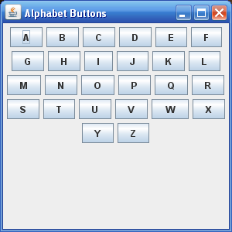
Twenty-six buttons placed with FlowLayout

Slide 40
Discussion
The buttons arranged by FlowLayout are not stretched or resized.
The buttons are placed consecutively one after the other. When there is no more room in the first row, the second row begins, etc.
Each row is centered in the frame, because the default constructor FlowLayout() uses center alignment.

Slide 41
GridLayout
The GridLayout layout manager arranges the components of a frame in a grid of specified dimensions, left to right, top to bottom, row by row.
GridLayout(int rows, int columns) where rows and columns specify the number of rows and columns in the grid.
GridLayout(int rows, int columns, int horizontalSpace, int verticalSpace) where rows and columns specify the number of rows and columns in the grid and horizontalSpace and verticalSpace are the horizontal and vertical gaps between components.
GridLayout() creates a grid with a single row and a column for each component.

Slide 42
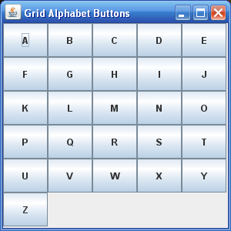
Buttons and GridLayout
Problem Statement
Place 26 “alphabet buttons” in a frame using GridLayout. The grid should have 6 rows and 5 columns

Slide 43
Buttons and GridLayout
import java.awt.*;
import javax.swing.*;
import java.util.*;
public class GridAlphabetButtons extends JFrame
{
public GridAlphabetButtons (int width, int height)
{ // width and height are frame dimensions
super("Grid Layout Alphabet Buttons");
setLayout(new GridLayout(6, 5)); // 6 rows; 5 columns
setBounds(0,0, width,height);
for (int i = 0; i < 26; i++)
{
Character alphabet = (char)(i + 'A');
JButton button = new JButton(alphabet.toString());
add(button);
}
}
public static void main(String[] args)
{
JFrame frame = new GridAlphabetButtons (300,300);
frame.setVisible(true);
frame.setDefaultCloseOperation(JFrame.EXIT_ON_CLOSE);
}
}

Slide 44
How to place components in a frame without a layout manager
By default, a frame uses the BorderLayout layout manager. To disable the default layout manager and place components in a frame without any assistance,
set the layout manager of the frame to null, using setLayout(null) and
use screen coordinates to place components

Slide 45
No Layout Manager
Problem Statement
Place three buttons, each of size 50 by 50, in a frame of size 300 by 300 such that:
the first button is placed at position (30,30),
the second button is placed at (220,30), and
the third button is placed at (125,125).

Slide 46
Solution
import javax.swing.*;
import java.awt.*;
public class NoLayoutManager extends JFrame
{
public NoLayoutManager()
{
super("No Layout manager");
setLayout(null); // no layout manager
setBounds(0,0, 300,300); // for the frame
// create the three buttons
JButton picture = new JButton( new ImageIcon("smiley.jpg"));
JButton smile = new JButton (":-)");
JButton frown = new JButton (":-(");
// set the position and size of each button
picture.setBounds(125,125,50,50);
smile.setBounds(30,30, 50,50);
frown.setBounds(220,30,50,50);

Slide 47
Solution
// add each button to the frame
add(picture);
add(smile);
add(frown);
setResizable
public static void main(String[] args)
{
JFrame frame = new NoLayoutManager();
frame.setVisible(true);
frame.setDefaultCloseOperation(JFrame.EXIT_ON_CLOSE);
}
}

Slide 48
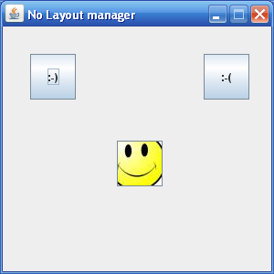
A frame created without a layout manager

